Slide 1
Database
MySQL Database
Session 1
Presented by: Ma Myint Myint

Slide 2
Installing MySQL Database
MySQL setup (server5.1)
Next/Complete/Next/Install/Next/Next/Finish/Next
Detailed Configuration
Developer Machine
Multifunctional Database
Path (No choose) Next
Online Transaction Processing(OLTP)
3306/Next
Standard/Next
New root password …> root
Confirm ….>root
Next
Execute
Finish

Slide 3
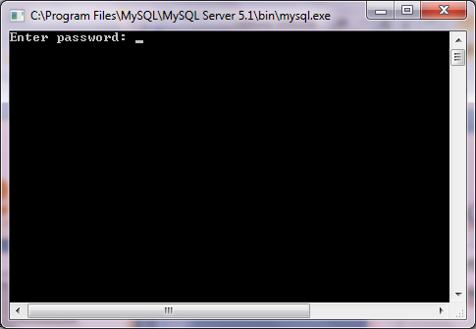
MySQL Database
Start/All Programs/MySQL / MySQL server 5.1
MySQL Command Line Client

Slide 4
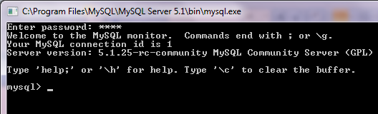
MySQL Database
Enter password: root (enter)

Slide 5
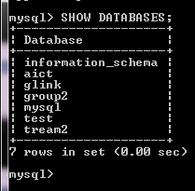
Show databases
Show the existing databases;
mysql> SHOW DATABASES;

Slide 6
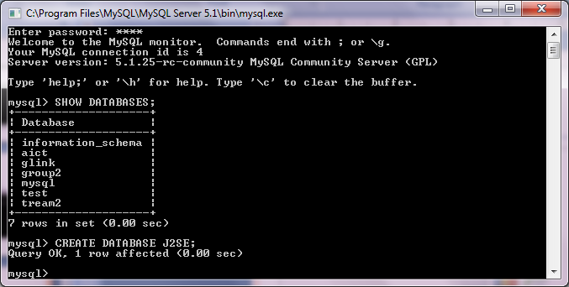
Create New Database
mysql> CREATE DATABASE database-name;
Eg: CREATE DATABASE J2SE;

Slide 7
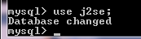
Use Existing database (or) Database change (or) Entering database
Mysql> USE database_name;
Eg: USE J2SE;

Slide 8
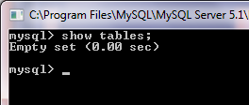
Show the existing tables
Mysql> show tables;

Slide 9
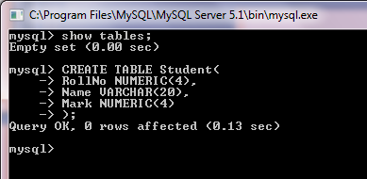
Create New Table
mysql > CREATE TABLE Student(
> RollNo NUMERIC(4),
> Name VARCHAR(20),
>Mark NUMERIC(4)
>);

Slide 10
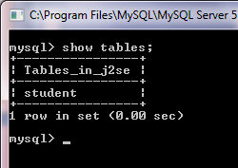
Show Tables
Mysql> show tables;

Slide 11
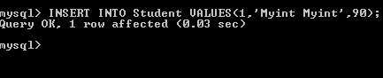
Inset data into the table
Mysql> INSERT INTO table-name VALUES
(col(1)’s-value, col(2)’s-value, col(3)’s-value);
Eg: INSERT INTO Student(1,’Myint Myint’,90);
Where, Numeric is integer No
Varchar(String) is using sigle code (‘ ’)

Slide 12
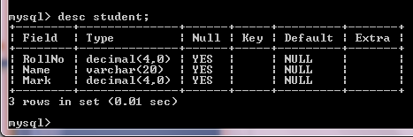
Show the detail information of existing table
Mysql>desc student;
This (desc) shows the detail information of field name, data type and Not null ,etc….

Slide 13
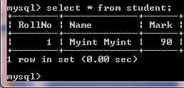
Query to the table
Mysql> SELECT * from table_name;
Eg: SELECT * FROM Student;

Slide 14
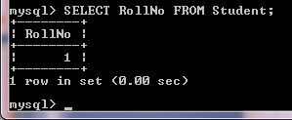
Query one column to the table
Mysql> SELECT col-name FROM table_name;

Slide 15
Relational Database Model

Slide 16
Data Model Building Blocks
Entities: Entities are the principle data object about which information is to be collected.
Attributes: Attributes describe the entity of which they are associated. A particular instance of an attribute is a value.
Relationships: Relationships describe an association among entities. There are three types such as:
1.One_to_many(1:M) relationship: this is when at most one instance of a entity A is associated with one instance of entity B.

Slide 17
Data Model Building Blocks
2. Many_to_Many(M:M) relationship: this is when for one for one instance of entity A, there are zero, one, or many instances of entity B, but for one instance of entity B, there is only one instance of entity A.
3. One_to_one(1:1) relationship: This is when for one instance of entity A, there are zero or one instance of entity B and for one instance of entity B there are zero or one instance of entity A.
Constraints: Constraints are restriction placed on the data. Constraints help to ensure data integrity.

Slide 18
Relational Database Model (Sample)
Department ID | Department
D01 | Sales
Department
1
M
Section ID | Section | Department ID
s01 | Asia Region | D01
s02 | Pacific Region | D01
Section
1
M
Employee ID | Name | Section ID
E001 | Aung | s01
Employee

Slide 19
Relational Database Model (Sample)
Customer ID | Customer
C01 | ABC Ltd.
C02 | XYZ Ltd.
Customer
1
Customer ID | Product ID | Quantity
C01 | P0001 | 10
C02 | P0002 | 36
C02 | P0001 | 200
M
Order
M
1
Product
Product ID | Product | Price
P0001 | Pencil | 3500
P0002 | Eraser | 6800

Slide 20
Key
Key Type | Definition
Super Key | An attribute or combination of attributes that uniquely identifies each row in a table.
Candidate Key | A minimal super key. A super key without redundant attributes.
Primary Key | A candidate key selected to use mainly. Null value does not allow for the primary key.
Foreign Key | An attribute or combination of attributes in one table whose values must either match the primary key in another table or be null.

Slide 21
Relational Algebra
Union: combines all rows from two tables excluding duplicates rows as shown in figure below:
R
S
R or S
A | B | C
1 | MM | Myanmar
2 | JP | Japan
A | B | C
1 | MM | Myanmar
3 | SG | Singapore
4 | MY | Malaysia
A | B | C
1 | MM | Myanmar
2 | JP | Japan
3 | SG | Singapore
4 | MY | Malaysia
R
S
R or S
R
S
R
S
=
R
S

Slide 22
Relational Algebra
Intersection: Intersect yields only the rows that appear in both tables as shown in Figure below:
S
R and S
R
A | B | C
1 | MM | Myanmar
2 | JP | Japan
A | B | C
1 | MM | Myanmar
3 | SG | Singapore
4 | MY | Malaysia
A | B | C
1 | MM | Myanmar
R
S
R and S
R
S
R
S
R
S
=

Slide 23
Relational Algebra
Difference: Difference yields all rows in one table that are not found in the other table as shown in Figure below:
R
S
A | B | C
1 | MM | Myanmar
2 | JP | Japan
A | B | C
1 | MM | Myanmar
3 | SG | Singapore
4 | MY | Malaysia
A | B | C
2 | JP | Japan
R
S
R - S
R
S
R
S
R
S
=

Slide 24
Relational Algebra
Product: Product yields all possible pairs of rows from two tables as shown in Figure below. This is equivalent with SQL statement of “SELECT * FROM R,S”.
R
1 | MM
2 | JP
S
X | xx
Y | yy
Z | zz
RxS
1 | MM | X | xx
1 | MM | Y | yy
1 | MM | Z | zz
2 | JP | X | xx
2 | JP | Y | yy
2 | JP | Z | zz

Slide 25
Relational Algebra
Projection: Projection yields all values for selected attributes. It means projection yields a vertical subset of a table as shown in Figure below.
R
R [attribute B]
A | B | C
1 | MM | Myanmar
2 | JP | Japan
B
MM
JP

Slide 26
Relational Algebra
Selection: Selection yields values for all rows found in a table. It can yield only those row values match a specified criterion as shown in Figure below.
R
R [Attribute A=1]
A | B | C
1 | MM | Myanmar
2 | JP | Japan
A | B | C
1 | MM | Myanmar

Slide 27
Relational Algebra
Join : Join yields information combined from two or more tables. Join links tables by selecting rows with common values in their common attributes as shown in two figures below:
R
S
R[R.A=S.A]
A | B
1 | MM
2 | JP
A | C
1 | Myanmar
2 | Japan
3 | Singapore
R.A | B | S.A | C
1 | MM | 1 | Myanmar
2 | JP | 2 | Japan
Equal Join

Slide 28
Relational Algebra
R
S
Natural Join
A | B
1 | MM
2 | JP
A | C
1 | Myanmar
2 | Japan
3 | Singapore
A | B | C
1 | MM | Myanmar
2 | JP | Japan
Natural Join

Slide 29
Relational Algebra
Division : Division is opposite operation of Product as shown in Figure below:
R
S
R÷S
A | B | X
1 | 11 | A
2 | 22 | A
1 | 11 | B
2 | 22 | B
1 | 11 | C
2 | 22 | C
A | B
1 | 11
2 | 22
X
A
B
C

Slide 30
Thank you!!!

